Slide 1

SOFTWARE DEVELOPMENT PRACTICES
FOREST
ONLINE SHOPPING APPLICATION
-Submitted by
Dhanesh P
Gokul M
Jagadish K G
Gnaanesh S A
IT-A- 1st year

Slide 2
Objective: FOREST Application is an online shopping platform which regulates shopping products, payments,bills,through internet .In our app it is user friendly and easy handling,with tons of offers and deals.
Users of the system:
*User (customers)
*Admin (manages the system)
User Registration (FR-1): Users can create new accounts by providing a unique username, email address, password, and other required information.
User Authentication (FR-2): Registered users can log in using their credentials (username and password).
Password Recovery (FR-3): Users can reset their passwords by requesting a password reset link via email.
User Profile (FR-4): Users can view and edit their profiles, including personal information, shipping addresses, and payment methods.
Functional requirements (FR):
User management:
Product Management:
Product Catalog (FR-5): The system displays a catalog of available products with details.
Product Search (FR-6): Users can search for products using keywords and filters (e.g., category, price range).
Product Details (FR-7): Users can view detailed information about a product by clicking on it in the catalog.

Slide 3
Shopping Cart
Add to Cart (FR-8): Users can add products to their shopping cart from the product details page.
View Cart (FR-9): Users can view the contents of their shopping cart, including product details, quantities, and total cost.
Update Cart (FR-10): Users can modify the quantity of items in the cart or remove items.
Empty Cart (FR-11): Users can empty their entire shopping cart.
Checkout and Payment
Proceed to Checkout (FR-12): Users can proceed to checkout from the shopping cart.
Shipping Information (FR-13): Users provide shipping details, including address and preferred shipping method.
Payment Information (FR-14): Users enter payment information, including credit card details or choose alternative payment methods (e.g., Google pay or cash on delivery etc.,).
Place Order (FR-15): Users can confirm and place their orders securely.
Order Confirmation (FR-16): Users receive an order confirmation email after successfully placing an order.
Order Management
Order History (FR-17): Users can view their order history, including order details and statuses (e.g., processing, shipped).
Order Tracking (FR-18): Users can track the status of their orders in real-time.

Slide 4
Review and Rating System
Product Reviews (FR-19): Registered users can write and submit reviews for products they have purchased.
Rating Products (FR-20): Users can rate products on a scale (e.g., 1 to 5 stars).
View Reviews (FR-21): Users can read product reviews and view average ratings on product detail pages.
Admin Panel
Product Management (FR-22): Administrators can add, edit, or delete products from the product catalog.
User Management (FR-23): Administrators can manage user accounts, including account suspension or deletion.
Order Processing (FR-24): Administrators can view and manage incoming orders, update order statuses, and mark orders as shipped.
Review Moderation (FR-25): Administrators can review and moderate user-submitted product reviews and ratings.
Non-Functional requirements (NFR):
Performance
Response Time (NFR-1): The system should respond to user interactions within 2 seconds to ensure a smooth shopping experience.
Scalability (NFR-2): The system should handle a gradual increase in users, and its performance should not significantly degrade as the user base grows.

Slide 5
Security
Data Encryption (NFR-3): User data, including passwords and payment information, must be encrypted during transmission and storage to protect against unauthorized access.
Authentication (NFR-4): User authentication should be robust, preventing unauthorized access to user accounts.
Authorization (NFR-5): Users should only have access to functions and data relevant to their roles (e.g., customer or admin).
Usability
User-Friendly Interface (NFR-6): The user interface should be intuitive and easy to use, with clear navigation and informative error messages.
Accessibility (NFR-7): The system should be accessible to users with disabilities, following accessibility standards and guidelines.
Reliability
Availability (NFR-8): The system should be available 24/7 with minimal downtime for maintenance, aiming for at least 99.9% uptime.
Data Backup (NFR-9): Regular backups of user data and system configurations should be performed to prevent data loss

Slide 6
Compliance
Legal Compliance (NFR-10): The system must comply with data protection and privacy laws (e.g., GDPR) and e-commerce regulations.
Security Standards (NFR-11): Payment processing must adhere to industry security standards, such as PCI DSS, to safeguard user payment information.
Performance Testing
Load Testing (NFR-12): The system should undergo load testing to ensure it can handle expected levels of user traffic.
Security Testing (NFR-13): Regular security testing should be conducted to identify and mitigate vulnerabilities.
APPLICATION ASSUMPTIONS
1. Application should open the login page when a new user enters
And the user can also close the login page and proceed to use application for 30hrs then it must automatically redirect the user to login page then after user must login compulsorly to use the app further…
3. Logging out must redirect to the login page
4. The valid email Id must be used
5. Valid strong password must be created by the user.

Slide 7
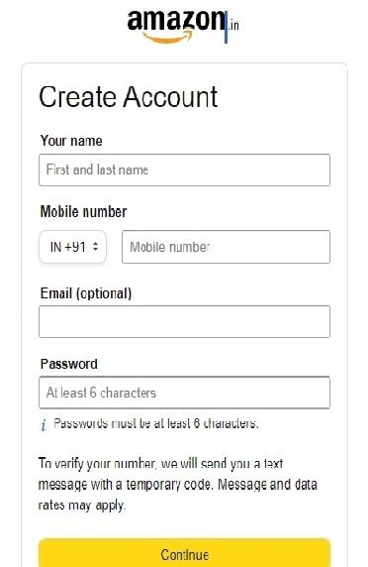
FRONTEND:
CUSTOMER:
Auth:
The customer can authenticate login and signup credentia l
Register:
The new customer has options to sign up by providing their basic details.
Username Email Password
Mobile Number
Output Screen:
FOREST

Slide 8
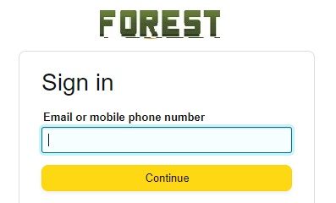
3. Login:
The existing customer can log in using the registered email id and password.
Mobile number Email (optional) Password
Output Screen:

Slide 9
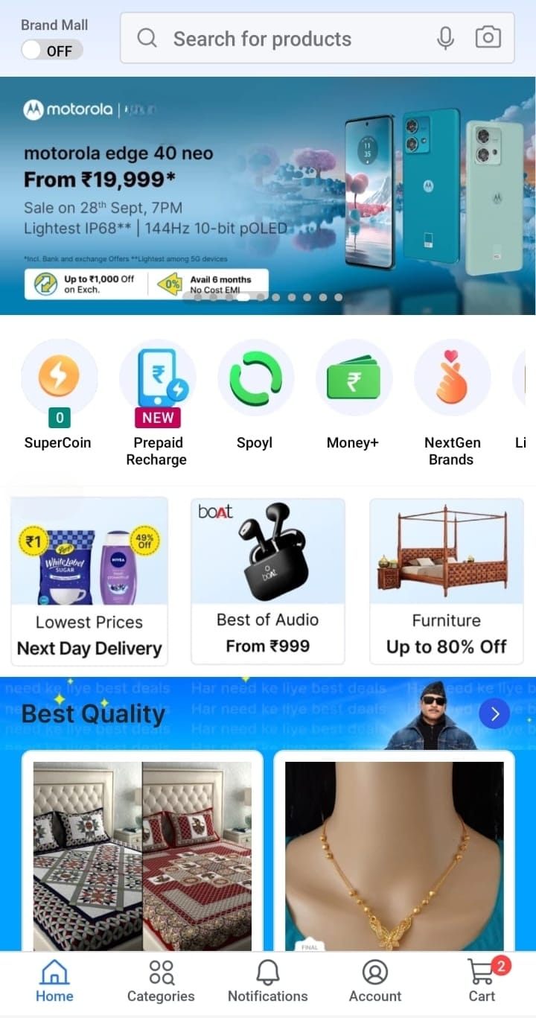
4.Dashboard:
A homepage which contains a recommendation of available products.
Output screen:

Slide 10
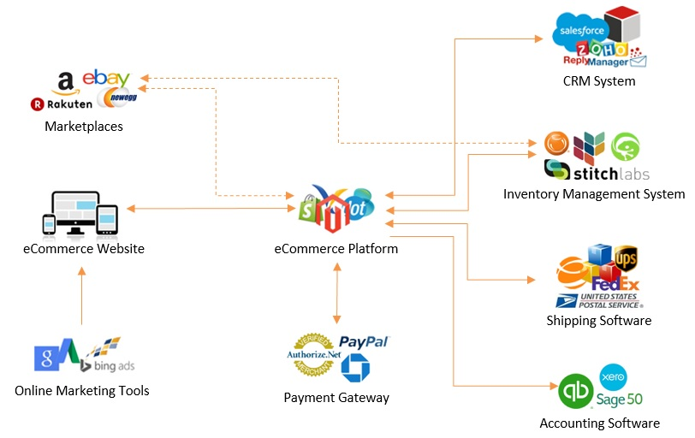
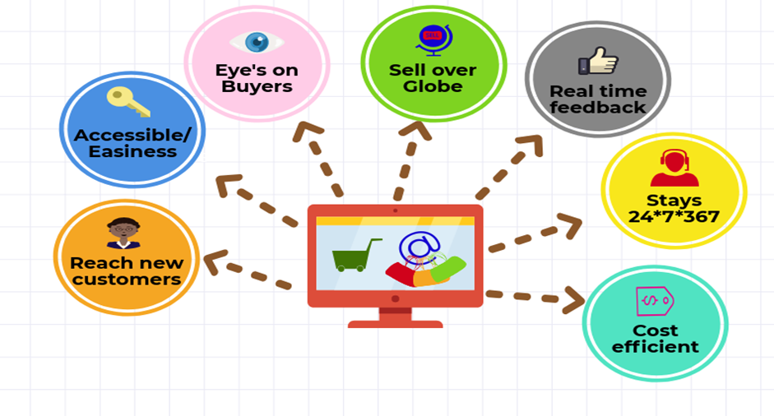

Slide 11
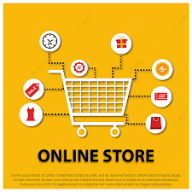
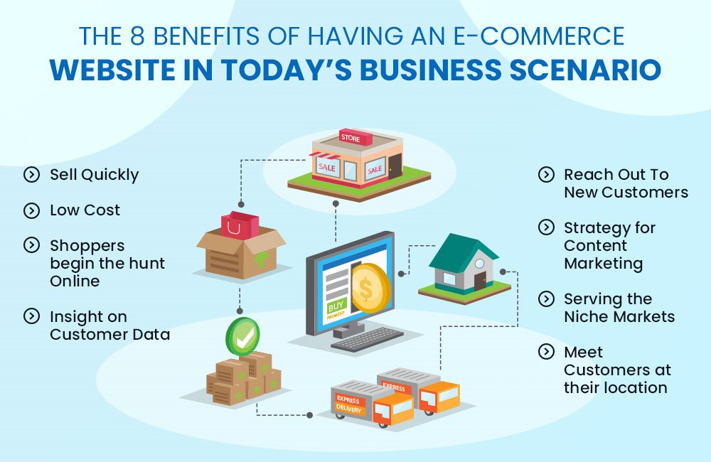

Slide 12
Backend:
The backend of the Online Shopping System consists of various components that work together to ensure the system's functionality. These components include:
1.1 User Model
The user model represents the user accounts in the system. It includes attributes such as username, email address, password, and user role. The user model is used for authentication and authorization purposes.
1.2 Login Model
The login model handles user authentication. It includes functions for validating user credentials, generating authentication tokens, and managing user sessions.

Slide 13
1.3 Prevention Model
The prevention model deals with security and prevention of unauthorized access. It includes mechanisms as input validation, encryption of sensitive data, and protection against common web vulnerabilities (e.g., SQL injection, cross-site scripting).
1.4 Statistics Model
The statistics model collects and processes data related to the system's usage and performance. It includes functions for generating reports and analyzing trends, such as sales statistics and user activity.
Controller:
The controller is responsible for handling user requests and managing the flow of data between the frontend and the backend. It includes functions for processing user, querying the database, and returning appropriate responses.

Slide 14
Signup Controller
The signup controller handles user registration. It include functions for validating user input, creating new user accounts, and sending confirmation emails (if required).
Login Controller
The login controller handles user authentication. It includes functions for validating user credentials, generating tokens, and managing user sessions.
Conclusion
The Online Shopping System is designed to provide an intuitive and secure platform for users to browse and purchase products online. The admin dashboard allows the admin to manage users, products, and orders effectively.

Slide 15
The backend components ensure the system's functionality, security, and performance. By implementing these features, the Online Shopping System aims to deliver a seamless and satisfying shopping experience for its users
THE END

